Slide 1
Theories of Sociology
Lecture 2

Slide 2
Theoretical Perspectives in Sociology
A sociological theory :
is a set of ideas that provides an explanation for human society. Theories are selective in terms of their priorities and perspectives and the data they define as significant. As a result they provide a particular and partial view of reality. Sociological theories can be grouped together according to a variety of criteria.
Theories have different scales:
-Macro-level theories, such as structural functionalism and conflict theory, attempt to explain how societies operate as a whole.
- Micro-level theories, such as symbolic interactionism, focus on interactions between individuals.

Slide 3
In sociology, a theory is a way to explain different aspects of social interactions and to create a testable proposition, called a hypothesis, about society
In sociology, a few theories provide broad perspectives that help to explain many different aspects of social life, and these are called paradigms.
Three paradigms have come to dominate sociological thinking because they provide useful explanations: structural functionalism, conflict theory, and symbolic interactionism

Slide 4
Structural Functionalism
Functionalism, also called structural-functional theory, sees society as a structure with interrelated parts designed to meet the biological and social needs of the individuals in that society.
English philosopher and biologist, Herbert Spencer (1898), saw similarities between society and the human body.
He argued that just as the various organs of the body work together to keep the body functioning, the various parts of society work together to keep society functioning.
The parts of society that Spencer referred to were the social institutions, or patterns of beliefs and behaviors focused on meeting social needs, such as government, education, family, healthcare, religion, and the economy.

Slide 5
Émile Durkheim applied Spencer’s theory to explain how societies change and survive over time. Durkheim believed that society is a complex system of interrelated and interdependent parts that work together to maintain stability and that society is held together by shared values, languages, and symbols.
For example, one function of a society’s laws may be to protect society from violence, while another is to punish criminal behavior, while another is to preserve public health

Slide 6
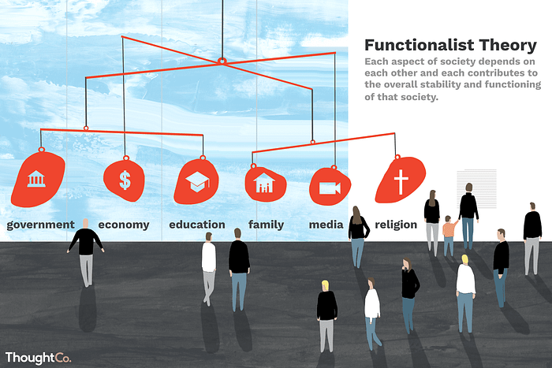

Slide 7
Social-Conflict paradigm
Conflict theory looks at society as a competition for limited resources.
This perspective is a macro-level approach most identified with the writings of German philosopher and sociologist Karl Marx, who saw society as being made up of individuals in different social classes who must compete for social, material, and political resources such as food and housing, employment, education, and leisure time.
Social institutions like government, education, and religion reflect this competition in their inherent inequalities and help maintain the unequal social structure.

Slide 8
Some individuals and organizations are able to obtain and keep more resources than others, and these “winners” use their power and influence to maintain social institutions.
German sociologist Max Weber agreed with Marx but also believed that, in addition to economic inequalities, inequalities of political power and social structure cause conflict.
Max Weber noted that different groups were affected differently based on education, race, and gender, and that people’s reactions to inequality were moderated by class differences and rates of social mobility, as well as by perceptions about the legitimacy of those in power

Slide 9


Slide 10
The symbolic –interaction paradigm
Symbolic interactionism is a micro-level theory that focuses on the relationships among individuals within a society.
Herbert Blumer (1969), coined the term “symbolic interactionism” and outlined these basic premises: humans interact with things based on meanings ascribed to those things; the ascribed meaning of things comes from our interactions with others and society; the meanings of things are interpreted by a person when dealing with things in specific circumstances.

Slide 11


Slide 12
Labeling Theory
Labeling theory is one of the most important approaches to understanding deviant and criminal behavior. It begins with the assumption that no act is intrinsically (basically) criminal. Definitions of criminality are established by those in power through the formulation of laws and the interpretation of those laws by police, courts, and correctional institutions.

Slide 13
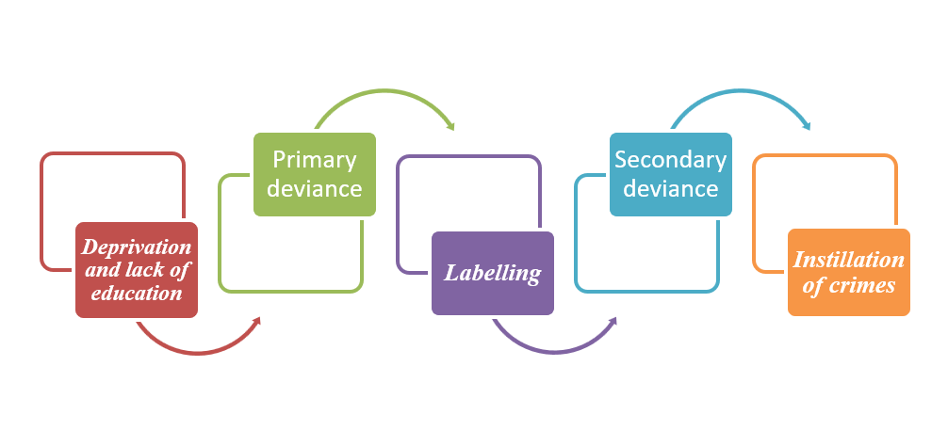

Slide 14


Slide 15
Social learning theory
Social learning theory is a theory that attempts to explain socialization and its effect of the development of the self. It looks at the individual learning process, the formation of self, and the influence of society in socializing individuals. Social learning theory is commonly used by sociologists to explain deviance and crime.

Slide 16
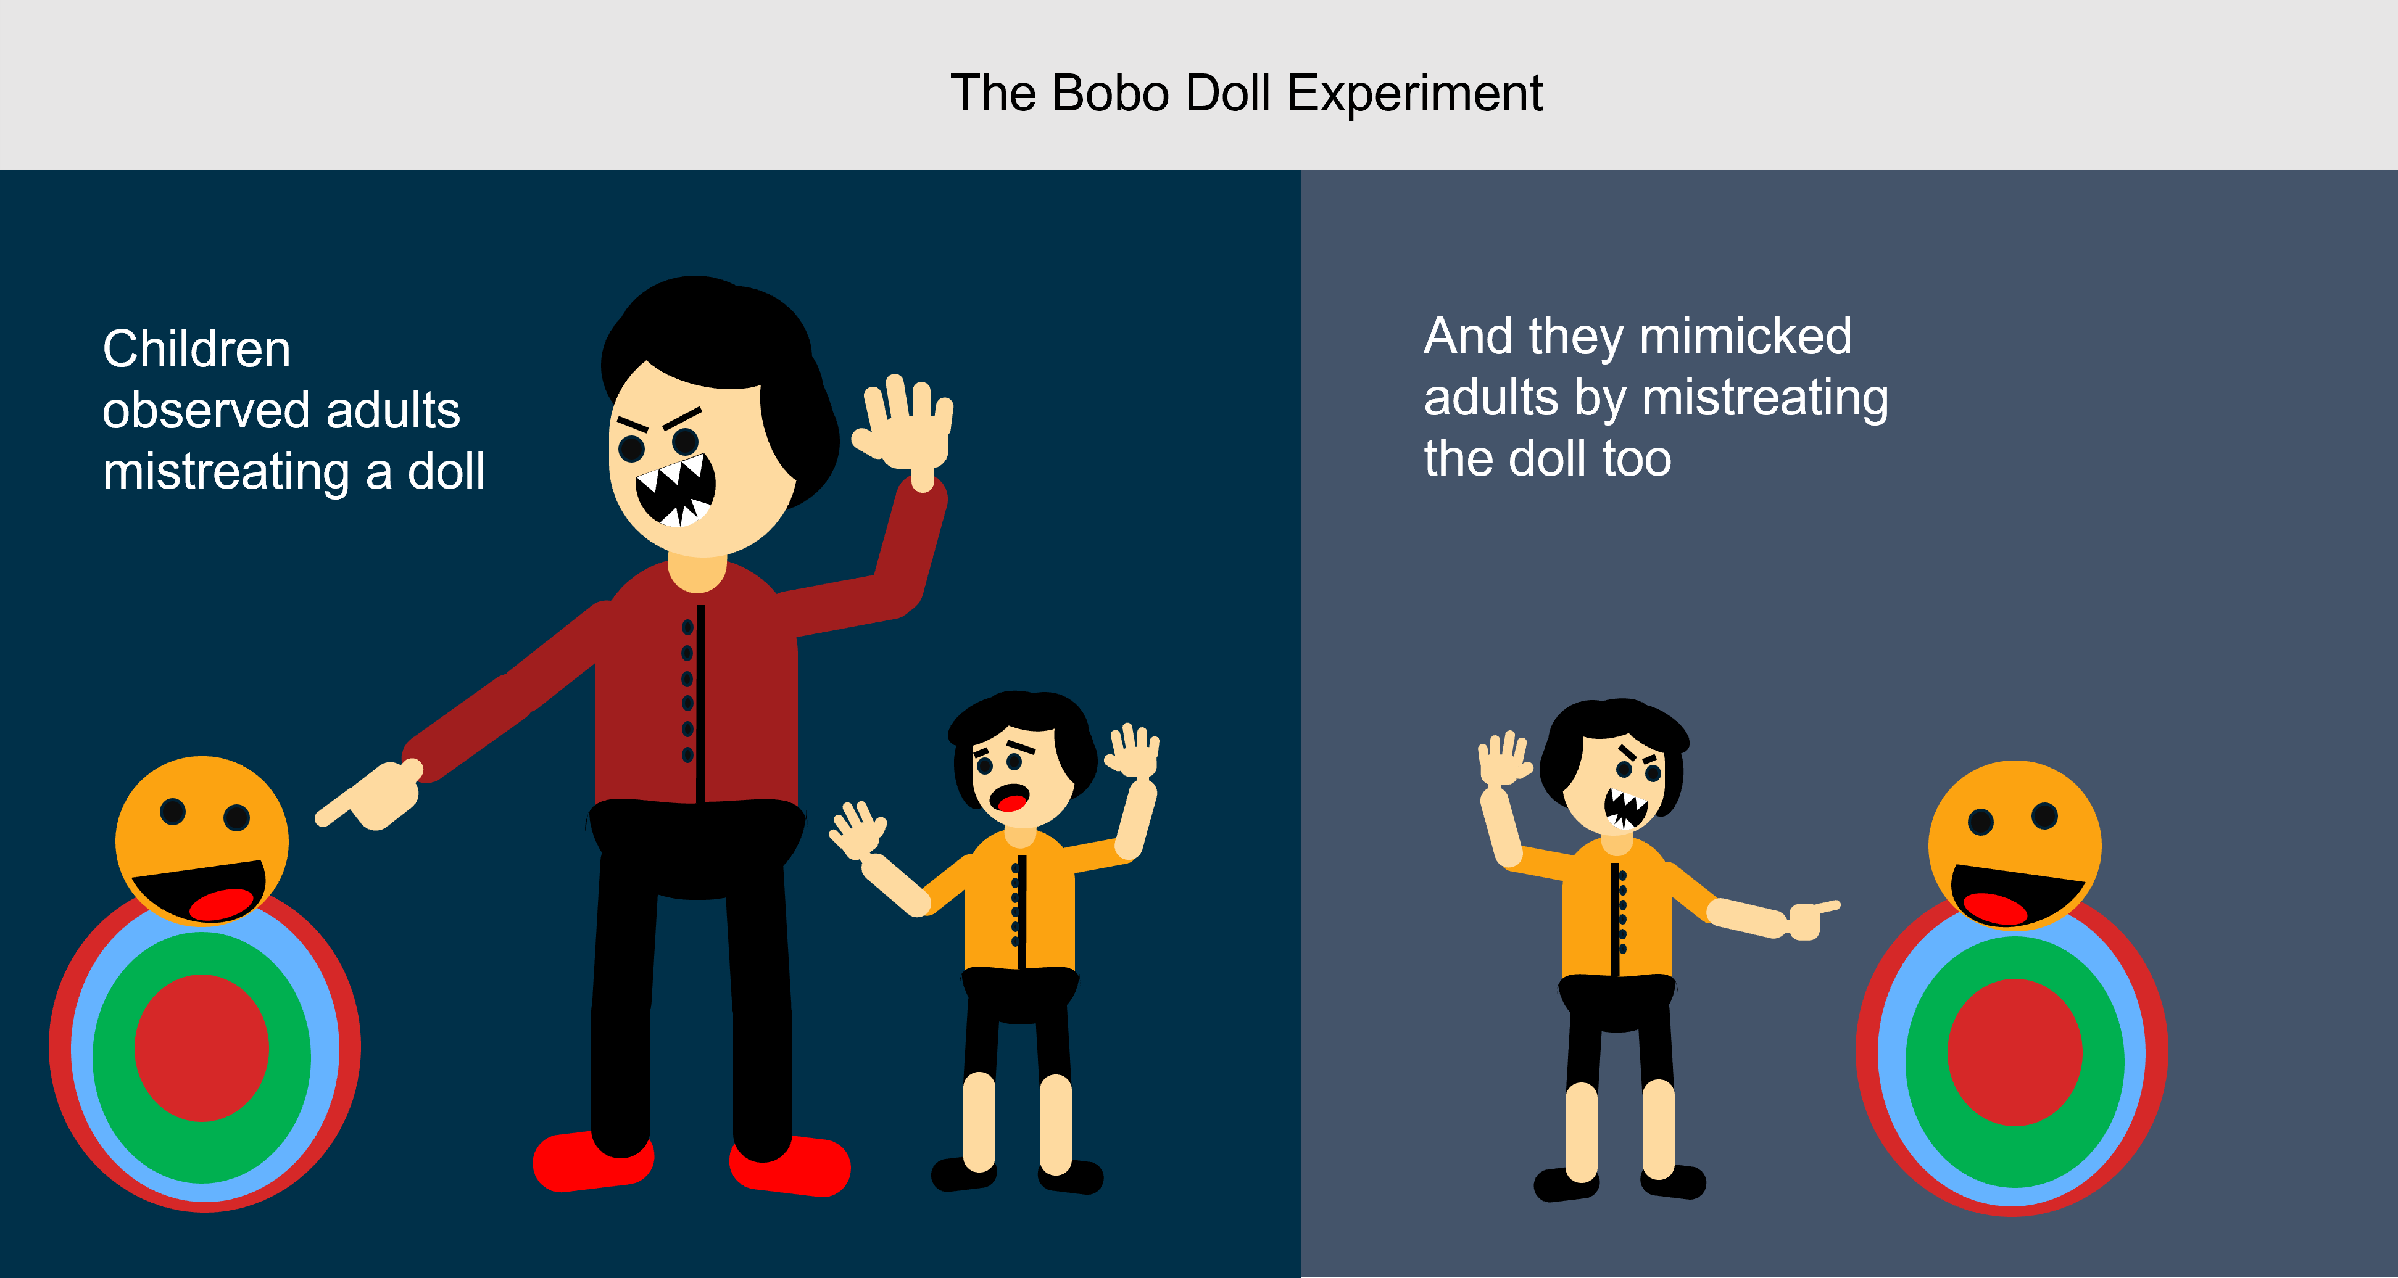

Slide 17
Rational Choice Theory
Economics plays a huge role in human behavior. That is, people are often motivated by money and the possibility of making a profit, calculating the likely costs and benefits of any action before deciding what to do. This way of thinking is called rational choice theory.

Slide 18


Slide 19
Medical Sociology
Theoretical science consists of a system of hypotheses theories that form the backbone of science such as the theory of social class and disease. What is the relationship between social classes and disease. E.g. the size of the family and its relationship to health and disease family with a large number of children is different from the family with a small number of children in terms of attention and care reflected on health and reduces the likelihood of infection.

Slide 20
Thank you

